Slide 1

JLW Capital
Investor Presentation
Your money, our plans.
RBS Fall 2022 - Jianqi Zhu, Jiayi Liu, Li Wang, Wenzhi Zhang

Slide 2
Table of contents
01
02
03
Fund Overview
Investment Management Team
Investment Strategy
04
05
06
07
Risk Management
Fund Performance
Competitive Advantage
Fund Terms

Slide 3

Fund Overview
01

Slide 4


Our company
We are committed to serve wealth growth and help the industry take off. Our experts constantly investigate secular trends and sustainability shifts, supported by in-depth fundamental investment analysis and proprietary ESG scoring, while our robust risk framework combined with our quantitative techniques leads to better investment and asset allocation decisions.

Slide 5

Investment Management Team
02

Slide 6

Organizational chart
Li Wang
CRO
Jiayi Liu
CFO
Wenzhi Zhang
CSO
Jianqi Zhu
CEO

Slide 7

Investment Strategy
03
Notes:
highlight : Fundamental analysis, Gradient boosting tree, Market neutral, Risk controlling trigger

Slide 8

Fundamental Analysis
Country
USA
Index
S&P 500
P/E
<20
ROE
>10%
Debt/Equity
<0.50
Market Cap
> $2 Billion USD

Slide 9
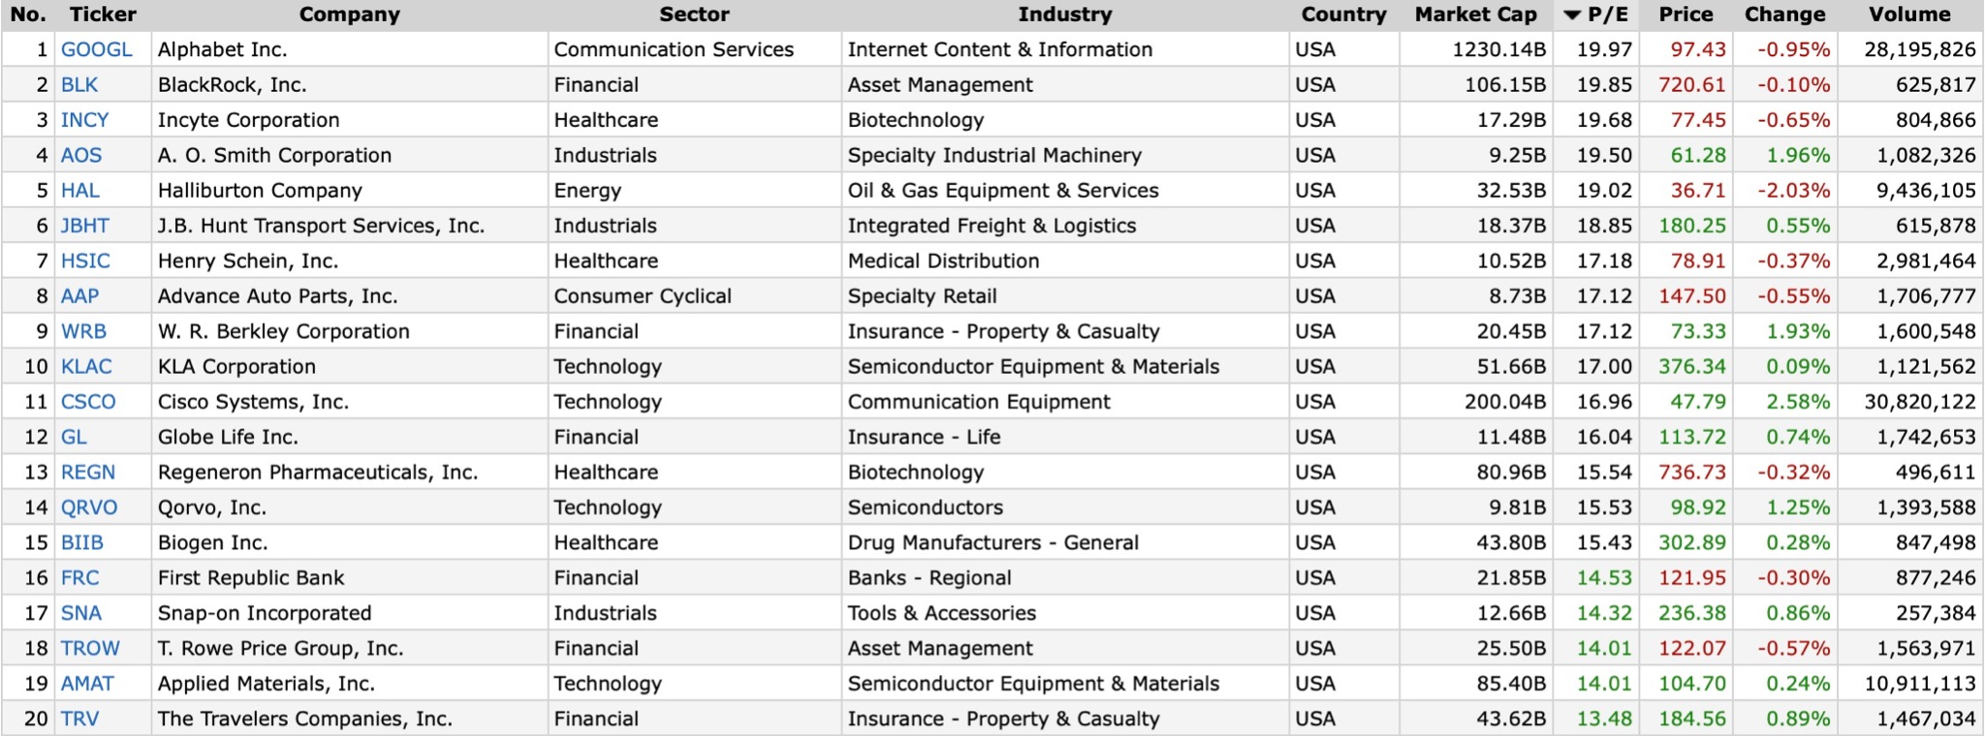
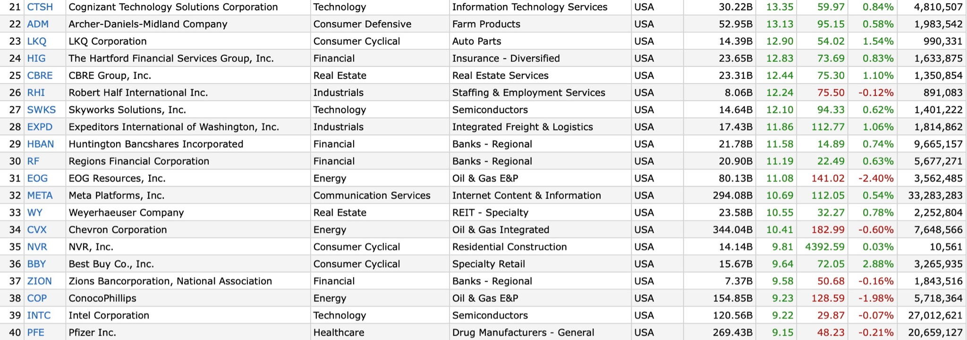

Slide 10
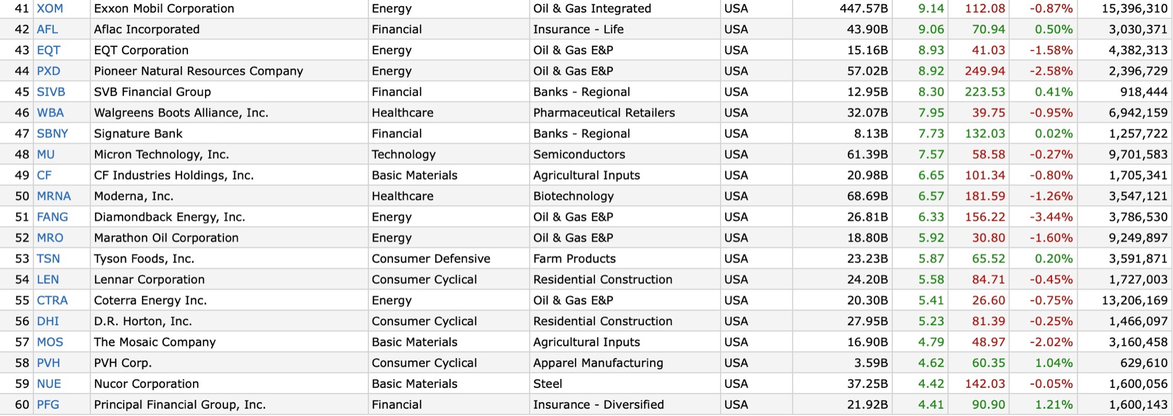

Slide 11
Technical Indicators
Relative Strength Index
Moving Average
Stochastic Oscillator
Bollinger Band
(1+return)/(1+index return)
3, 5, 20, 50, 200-day moving average
(close - low)/(high - low)
20-period moving average ± 2 × 20-period standard deviation

Slide 12
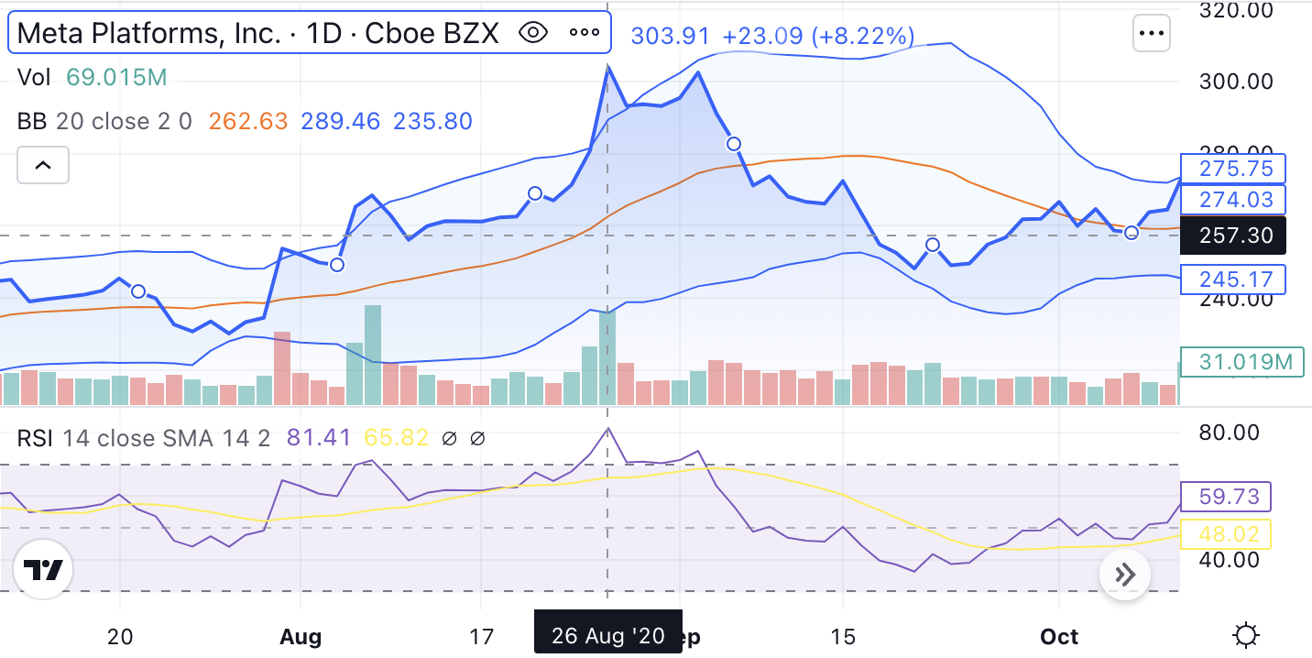
Technical Analysis
The technical indicators are indeed sometimes contradictory.
For example, on Aug 26, 2020, the over 70% RSI is a bullish signal, but the Bollinger band shows it is overbought.
Instead of simply comparing how many bullish and bearish indicators, our model determines the most rational threshold for each indicators

Slide 13
Strategy & Implementation
Step 1
Step 2
Step 3
Step 4
Step 5
Calculate the technical indicators
Label the stock performance, if it daily return is better than 70% of previous time, we label it as “up”. If it is worse than 30% of previous time, we label it as “down.”
Train a gradient boosting tree model to determine the threshold of each indicators. Calculate the score of each asset.
Optimize the weights by maximizing the total score of the portfolio, under the constraint of market neutral.
Dynamically adjust the position of bond ETF to reduce the portfolio risk.

Slide 14
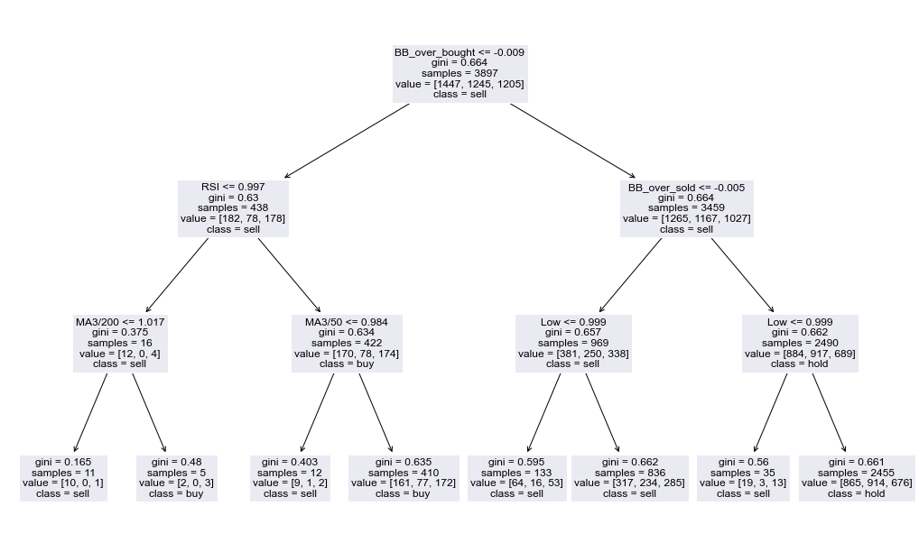
Strategy & Implementation
This is a simplified version of how our model make rational decisions. Calculate today’s technical indicators and follow the tree.!
It will tell you what is the threshold of each technical indicator for a stock/ETF (Pfizer in this example).

Slide 15

Risk
Management
04

Slide 16
Risk Management Policies
Individual stock investment positions < 10%
Leverage < 2X
Dynamic adjustment of strategy based on market conditions
Minimize loss by exiting all positions for any -10% loss per month
Dynamic adjustment of proportion of equity investment according to strategy performance
The proportion of equity investment would be adjusted to 70%, when the cumulative PNL is negative.

Slide 17
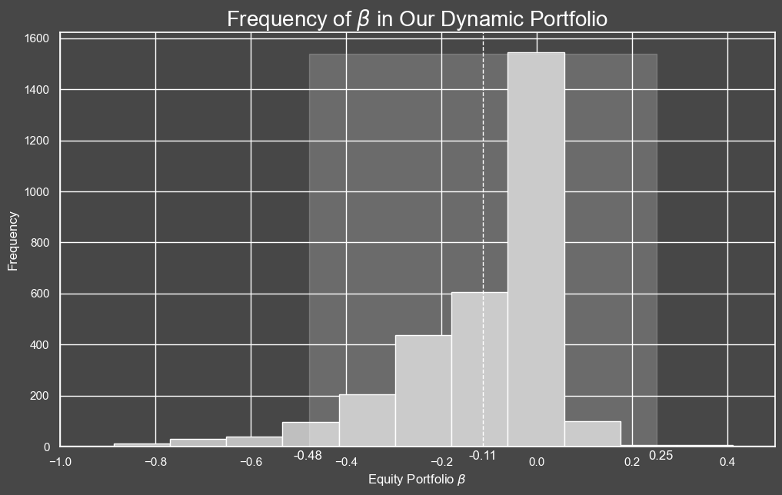
Market Neutral
We further optimize the asset allocation. The objective is to increase the total score of our portfolio while penalizing the deviation from market neutral.
The β of our equity portfolio lies between -0.48 and 0.25 in 95% of time.

Slide 18

Fund Performance
05

Slide 19
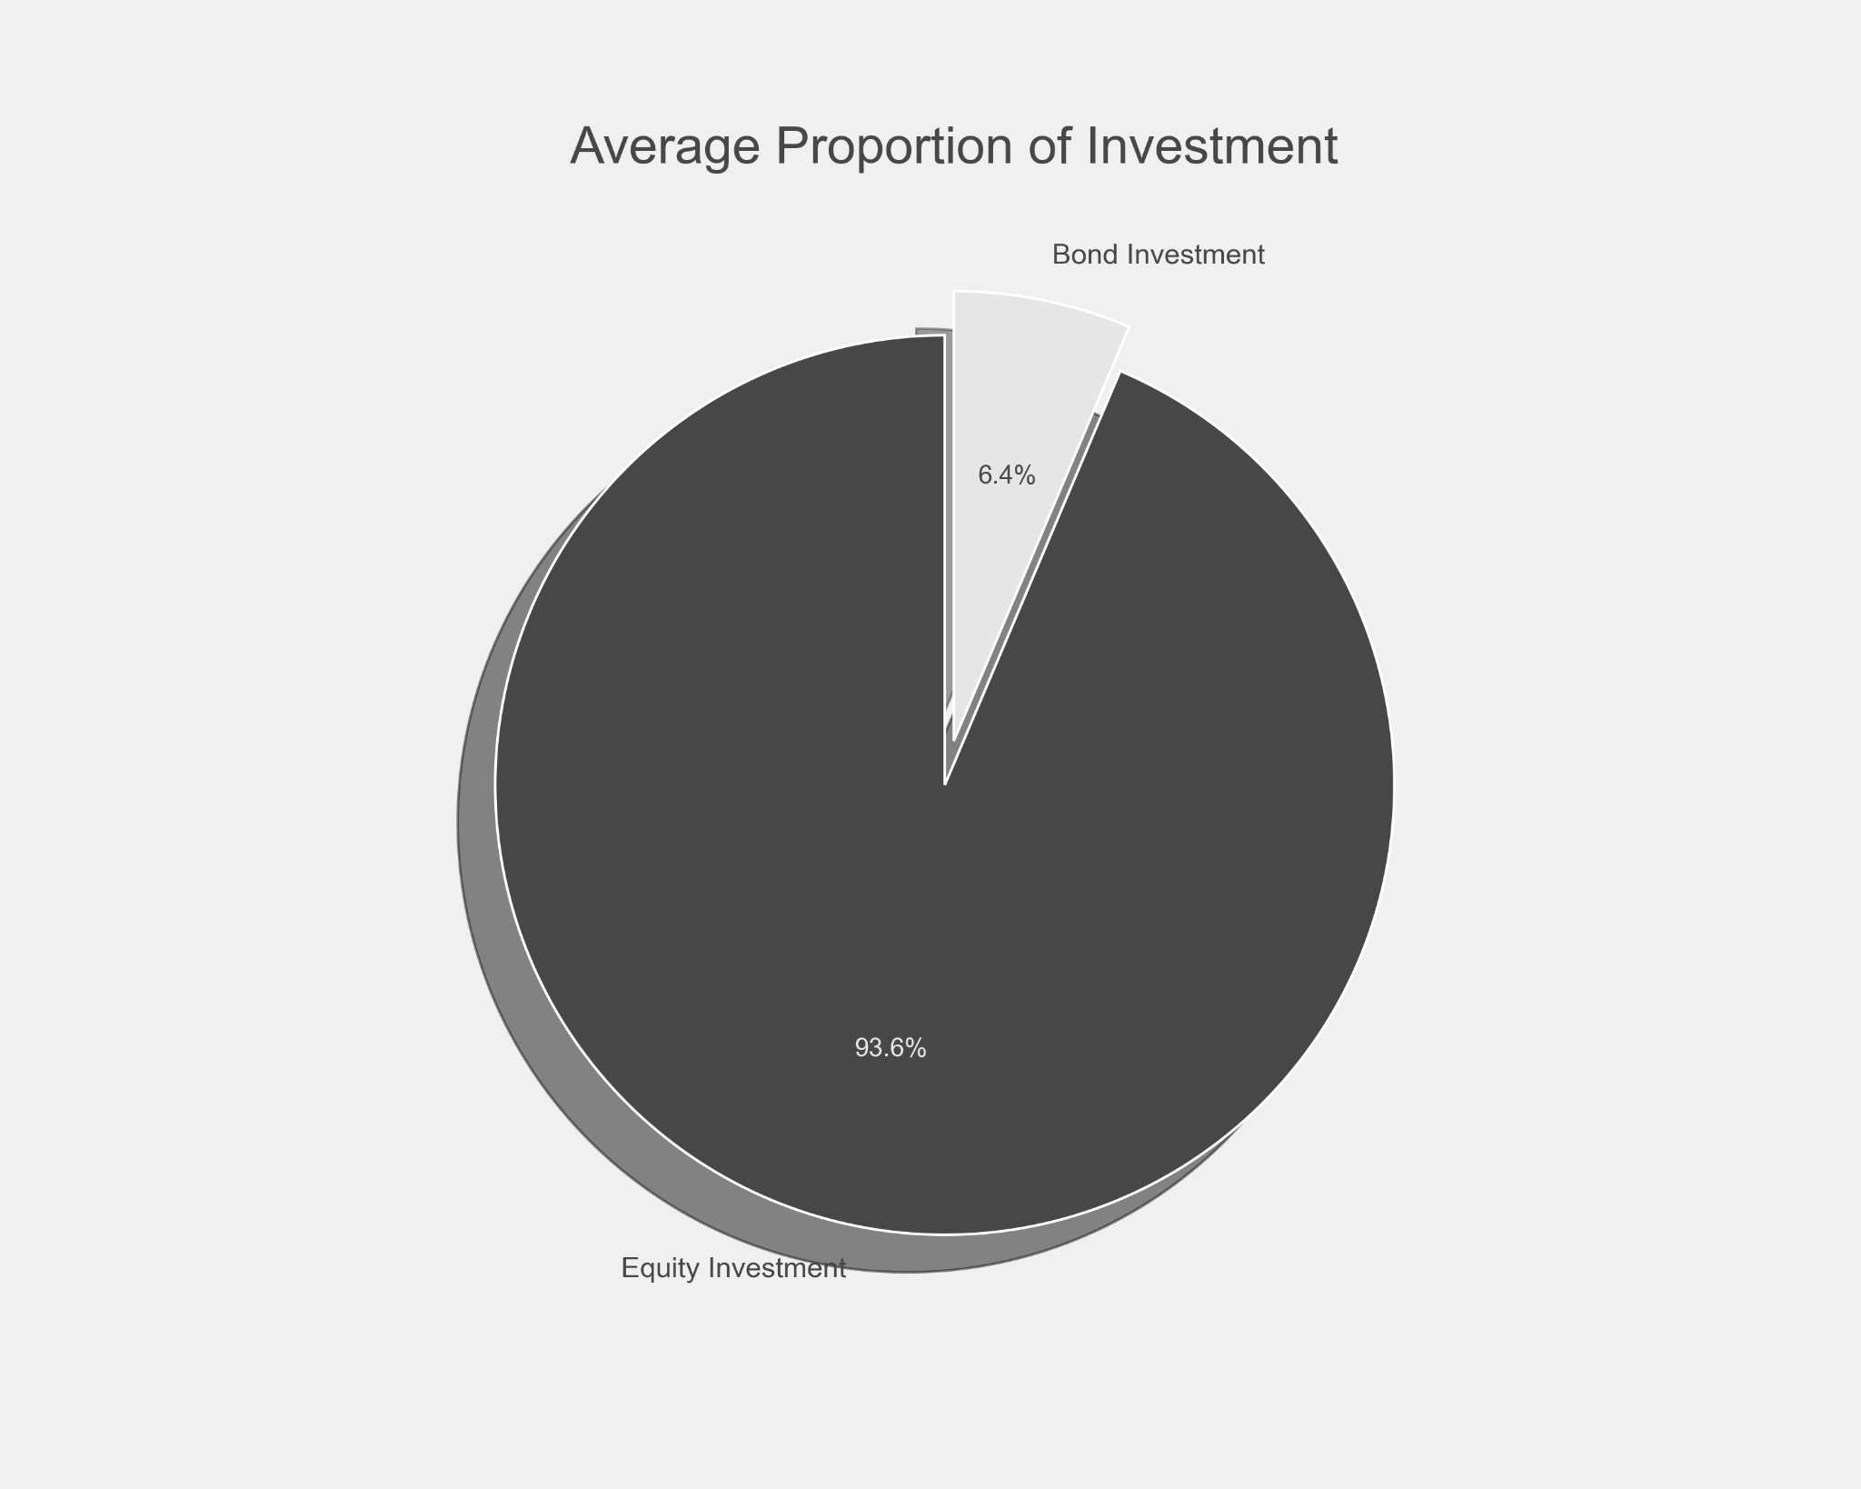
Asset Allocation

Slide 20
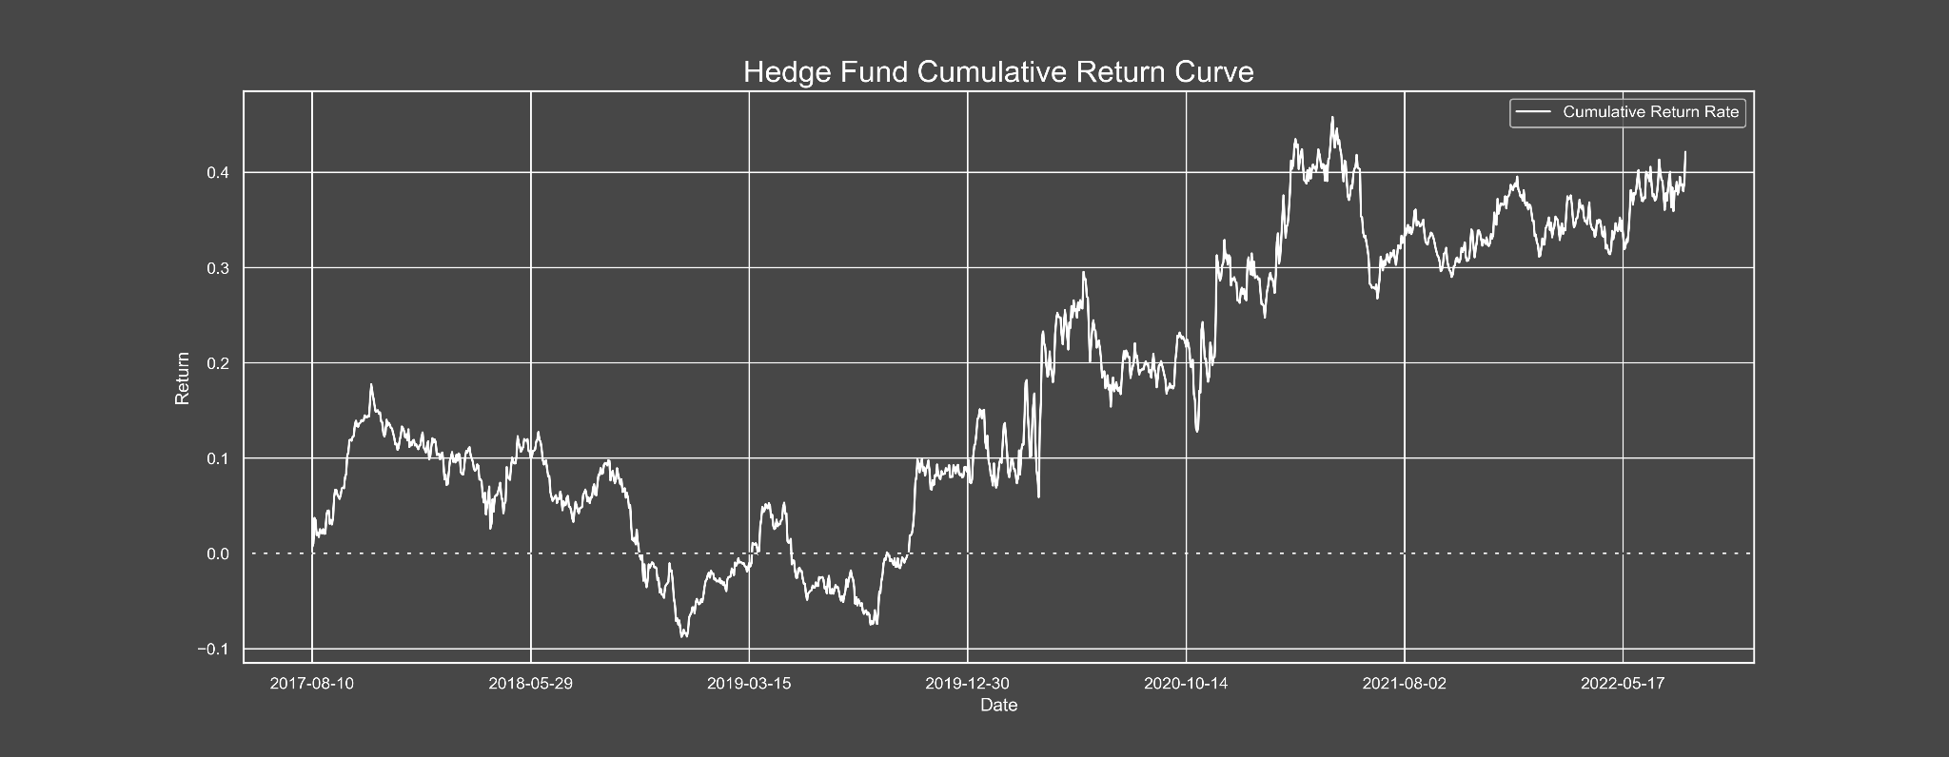
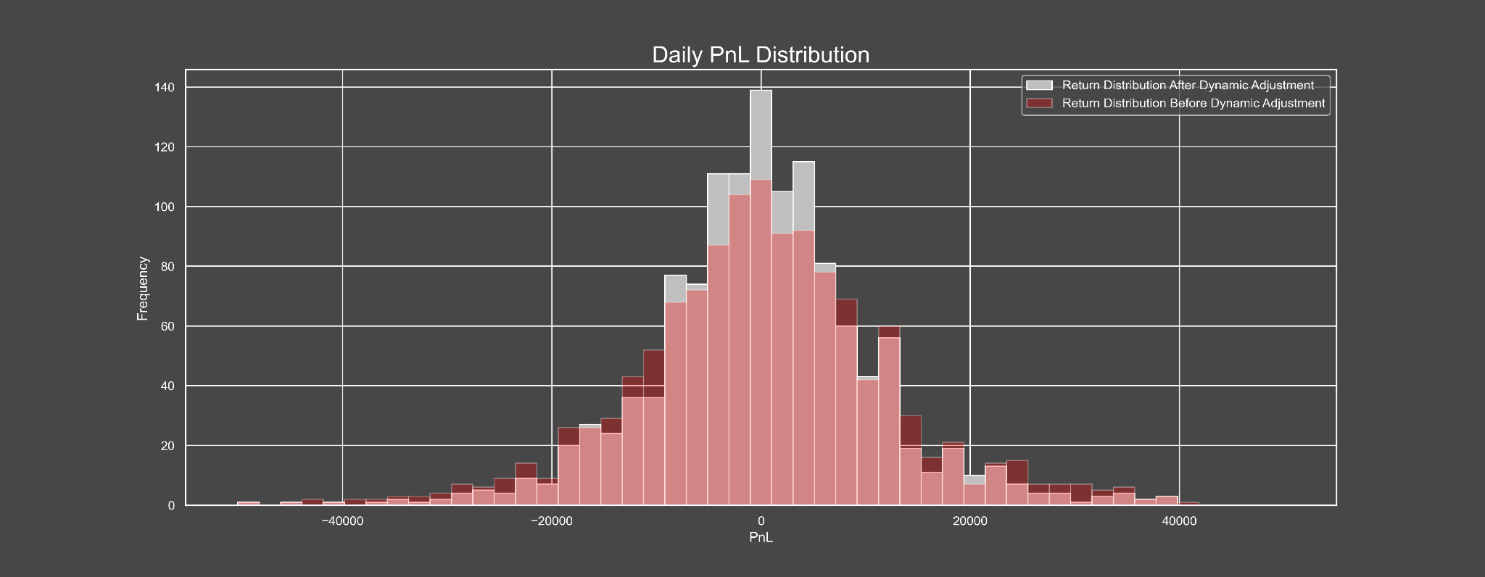
Cumulative Return
8.043%
Daily PnL

Slide 21
Sharpe Ratio
Sortino Ratio
Standard deviation 0.153
Annual sharpe ratio = 0.389
The investor risk increases by 1%, and the income is increased by 0.389%.
Annual sortino ratio = 0.613
The investor risk increases by 1%, and the income is increased by 0.613%.
Max Drawdown 26.5011%

Slide 22

Competitive Advantage
06

Slide 23

Why JLW Capital
Positive Impact
Industry Leader
Comprehensive Training
Professional Team
Insights,
Guidance,
Services

Slide 24

Combination of Fundamental and Technical analysis
We learn from the class that Combining fundamental and technical analysis may result in the best performance. Quantitative analysis also play an important role in optimizing the portfolio and in risk management

Slide 25
Market Neutral
Mitigating market risk
Providing diversification portfolio
Does not influence by the bear or bull market

Slide 26
Fund Terms
07

Slide 27

Fund Registration
New York, NY, USA
Total Fund
$500 Million
Fund Manager Contribution
$100 Million
Minimum Investment
$25 Million
Fees
Management fee 2% | Performance Fee 20%
Lock-up Period
5 years

Slide 28
Disclaimer
The information set forth herein has been obtained or derived from sources believed by JLW Capital Management, LLC (“JLW”) to be reliable. However, JLW does not make any representation or warranty, express or implied, as to the information’s accuracy or completeness, nor does JLW recommend that the attached information serve as the basis of any investment decision. This document has been provided to you solely for information purposes and does not constitute an offer or solicitation of an offer, or any advice or recommendation, to purchase any securities or other financial instruments, and may not be construed as such. This document is intended exclusively for the use of the person to whom it has been delivered by JLW and it is not to be reproduced or redistributed to any other person. This document is subject to further review and revision.
This presentation is not research and should not be treated as research. This presentation does not represent valuation judgments with respect to any financial instrument, issuer, security or sector that may be described or referenced herein and does not represent a formal or official view of JLW.
The views expressed reflect the current views as of the date hereof and neither the speaker nor JLW undertakes to advise you of any changes in the views expressed herein. It should not be assumed that the speaker will make investment recommendations in the future that are consistent with the views expressed herein, or use any or all of the techniques or methods of analysis described herein in managing client accounts. JLW and its affiliates may have positions (long or short) or engage in securities transactions that are not consistent with the information and views expressed in this presentation.
The information contained herein is only as current as of the date indicated, and may be superseded by subsequent market events or for other reasons. Charts and graphs provided herein are for illustrative purposes only. The information in this presentation has been developed internally and/or obtained from sources believed to be reliable; however, neither JLW nor the speaker guarantees the accuracy, adequacy or completeness of such information. Nothing contained herein constitutes investment, legal, tax or other advice nor is it to be relied on in making an investment or other decision.
There can be no assurance that an investment strategy will be successful. Historic market trends are not reliable indicators of actual future market behavior or future performance of any particular investment which may differ materially, and should not be relied upon as such. Target allocations contained herein are subject to change. There is no assurance that the target allocations will be achieved, and actual allocations may be significantly different than that shown here. This presentation should not be viewed as a current or past recommendation or a solicitation of an offer to buy or sell any securities or to adopt any investment strategy.
The information in this presentation may contain projections or other forward‐looking statements regarding future events, targets, forecasts or expectations regarding the strategies described herein, and is only current as of the date indicated. There is no assurance that such events or targets will be achieved, and may be significantly different from that shown here. The information in this presentation, including statements concerning financial market trends, is based on current market conditions, which will fluctuate and may be superseded by subsequent market events or for other reasons. Performance of all cited indices is calculated on a total return basis with dividends reinvested.
The investment strategy and themes discussed herein may be unsuitable for investors depending on their specific investment objectives and financial situation. Please note that changes in the rate of exchange of a currency may affect the value, price or income of an investment adversely.
Neither JLW nor the speaker assumes any duty to, nor undertakes to update forward looking statements. No representation or warranty, express or implied, is made or given by or on behalf of JLW, the speaker or any other person as to the accuracy and completeness or fairness of the information contained in this presentation, and no responsibility or liability is accepted for any such information. By accepting this presentation in its entirety, the recipient acknowledges its understanding and acceptance of the foregoing statement.

Slide 29

Thanks
Do you have any questions?

